Slide 1
MySQL Executable Objects
目的：
嵌入式SQL
过程化SQL
参考课本第8章和5.7节
内容：
  存储函数，存储过程，触发器，事件
  变量范围
  流程控制语句IF Then， Loop，Case
  游标

Slide 2
MySQL Executable Objects (1)
存放在MySQL服务器端，供重复使用的对象叫做存储程序。存储程序分为以下四种：
（1）存储过程（ Stored procedures ）：不直接返回一个计算结果，但可以用来完成一般的运算或是生成一个结果集并传递回客户端。
一条SQL语句如果比作一行java代码，存储过程就相当于一个java方法，可以包含许多SQL语句，进行更复杂的操作。
（2）存储函数（ Stored functions ）：返回一个计算结果，该结果可以用在表达式里。
就相当于自定义MySQL函数一样，它的作用和MySQL函数类似，只不过需要我们自己去定义。
（3）触发器（ Triggers ）：与数据表相关联，当那个数据表被INSERT、DELETE或UPDATE语句修改时，触发器将自动执行。
如果表关联了触发器，当表数据有修改操作时，触发器将自动执行，至于做什么是自己定义的。
（4）事件（ Events ）：根据时间表在预定时刻自动执行。
比如，可以自己定一个开始时间点，然后让它每隔指定的时间段重复做某些事情。

Slide 3
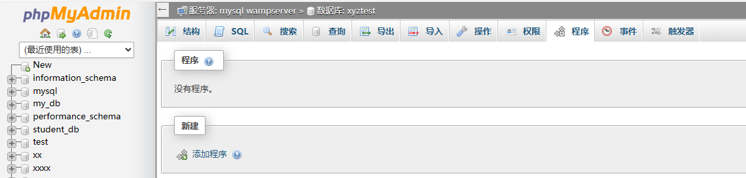
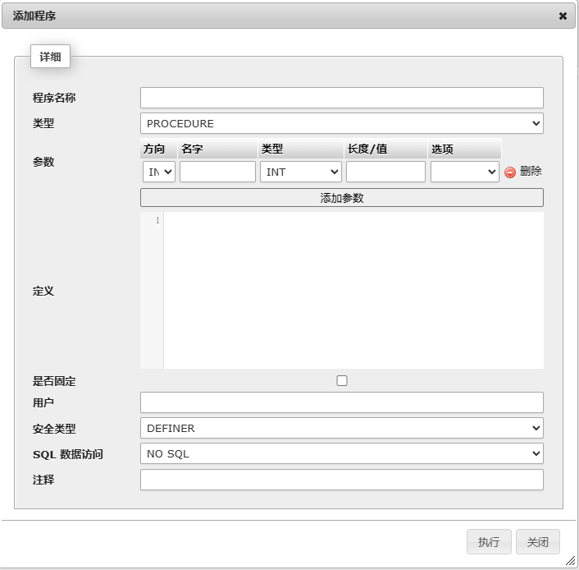
MySQL Executable Objects (1)
存放在MySQL服务器端，供重复使用的对象叫做存储程序。存储程序分为以下四种：
（1）存储过程（ Stored procedures ）：不直接返回一个计算结果，但可以用来完成一般的运算或是生成一个结果集并传递回客户端。
一条SQL语句如果比作一行java代码，存储过程就相当于一个java方法，可以包含许多SQL语句，进行更复杂的操作。
（2）存储函数（ Stored functions ）：返回一个计算结果，该结果可以用在表达式里。
就相当于自定义MySQL函数一样，它的作用和MySQL函数类似，只不过需要我们自己去定义。
（3）触发器（ Triggers ）：与数据表相关联，当那个数据表被INSERT、DELETE或UPDATE语句修改时，触发器将自动执行。
如果表关联了触发器，当表数据有修改操作时，触发器将自动执行，至于做什么是自己定义的。
（4）事件（ Events ）：根据时间表在预定时刻自动执行。
比如，可以自己定一个开始时间点，然后让它每隔指定的时间段重复做某些事情。

Slide 4
MySQL Executable Objects (2)
存储程序优点
  重复使用
  运行效率高
  存储程序都保存在服务端，降低了客户机和服务器之间的通信量
  可以提高数据库安全性，可以限制存储程序的访问权限。

Slide 5
MySQL Executable Objects (1)
存放在MySQL服务器端，供重复使用的对象叫做存储程序。存储程序分为以下四种：
（1）存储过程（ Stored procedures ）：
create procedure proc_name ([parameters])
routine_body
（2）存储函数（ Stored functions ）：
create function func_name ([parameters])
returns data_type
routine_body
（3）触发器（ Triggers ）：
create trigger trigger_name <触发器名>
{ before | after }
{ insert | update | delete } <触发事件> ON <表名>
（4）事件（ Events ）：
create event event_name
on schedule schedule_spec
do event_body;

Slide 6
A Simple MySQL Stored Procedure
(存储过程)
Get all employee details.
mysql > delimiter // -- replace default statement delimiter ; by //
mysql > create procedure GetAllEmployees()
begin
select * from employees;
end //
mysql > delimiter ; -- make ; the statement delimiter again
Calling Stored Procedure :
mysql > call GetAllEmployees();
DELIMITER 定好结束符为“\\", 然后最后又定义为";", MYSQL的默认结束符为";".

Slide 7
变量Variables
存储程序可以有他们自己的变量.
变量声明 declare :
declare variable_name datatype [default default_value];
  Datatype can be any type supported by MySQL.
Examples: declare total_sale int default 0;
declare x, y int;
Assign values to variables:
Examples: declare total_count int;
  set total_count = 10;
declare total_counts int;
select count(*) into total_counts from employees;
Notes:
Declare 声明局部变量

Slide 8
变量作用范围Variable Scope
If you declare a variable inside a stored procedure, it will be out of scope when the end statement of stored procedure is reached.
If you declare a variable inside a begin-end block, it will be out of scope if the end is reached.
A variable that begins with the @ sign at the beginning is a session variable（会话变量）. It is available and accessible until the end of the session.
Notes:
一个客户连接服务器，为一个会话，会话变量不需要declare 声明

Slide 9
@variable
MySQL has the concept of session variables. They are loosely typed variables that may be initialized somewhere in a session and keep their value until the session ends.
They are with an @ sign, like this: @var
You can initialize @ variables like
  mysql> set @x = 1;
  mysql> select @x;

Slide 10
Another Example (1)
mysql> delimiter //
mysql> create procedure prc_test ( )
begin
declare var2 int default 1;
set var2 := var2 + 1;
set @var2 := @var2 + 1;
select var2, @var2;
end //
mysql> delimiter ;

Slide 11
Another Example (2)
mysql > set @var2 = 1;
mysql > call prc_test();
  output:
  var2 @var2
  ----- --------
  2 2
mysql > call prc_test();
  var2 @var2
  ----- --------
  2 3
mysql > call prc_test();
  var2 @var2
  ----- --------
  2 4
@ variables can carry their values across different procedure calls.

Slide 12
Basic Syntax of Stored Procedures/Functions
存储过程/函数基本语法
Procedures
create procedure proc_name ([parameters])
routine_body
Functions
create function func_name ([parameters])
returns data_type routine_body
存储函数必须指定返回的类型
Parameter definition:
[ in | out | inout ] param_name data_type（数据类型）
  “in” is the default
  Only in parameter can be used for function
Notes:
IN 输入参数
表示该参数的值必须在调用存储过程时指定，在存储过程中修改该参数的值不能被返回，为默认值
仅需要将数据传入存储过程，并不需要返回计算后的该值。
只能当做传入参数
OUT 输出参数
该值可在存储过程内部被改变，并可返回
不接受外部传入的数据，仅返回计算之后的值。
只能当做转出参数
INOUT 输入输出参数
调用时指定，并且可被改变和返回
需要数据传入存储过程经过调用计算后，再传出返回值
可当做传入转出参数

Slide 13
Parameter Modes
IN: Default mode.
  The calling program must pass an argument to each in parameter.
OUT
  The value of an out parameter can be changed inside the stored procedure and its new value is passed back to the calling program.
INOUT
  Combination of in & out

Slide 14
Example 3
Create a procedure to return the number of students in any given department.
mysql> delimiter //
mysql> create procedure GetStudentSizeByDept(in deptname varchar(50))
begin
select count(*) from Students
where dept_name = deptname;
end //
mysql> delimiter ;
mysql> call GetStudentSizeByDept(‘CS’);

Slide 15
Example 3: Another Way
Another way to write the procedure in the previous slide.
mysql> delimiter //
mysql> create procedure GetStudentSizeByDept1(in deptname varchar(50), out num_of_students int)
begin
select count(*) into num_of_students
from Students
where dept_name = deptname;
end //
mysql> delimiter ;
mysql> call GetStudentSizeByDept1(‘CS’, @num_of_students);
mysql> select @num_of_students;
存储过程可以有返回值，也可以没有返回值

Slide 16
Example 4
Create a function to return the number of students in any given department.
mysql> delimiter //
mysql> create function GetStudentSizeByDept2(in deptname varchar(50)) returns int
begin
declare num_of_students int;
select count(*) into num_of_students from Students
where dept_name = deptname;
return (num_of_students);
end //
mysql> delimiter ;
mysql> select GetStudentSizeByDept2(‘CS’);
存储函数必须指定返回的类型

Slide 17
Example 4: Another Way
Here is another way to write the function in the previous slide.
mysql> delimiter //
mysql> create function GetStudentSizeByDept2(in deptname varchar(50)) returns int
begin
return (select count(*) from Students
where dept_name = deptname);
end //
mysql> delimiter ;

Slide 18
Example 5
mysql> delimiter //
mysql> create procedure set_counter(inout count int(4),
in increment int(4))
begin
set count = count + increment;
end //
mysql> delimiter ;
mysql> set @counter = 1;
mysql> call set_counter(@counter, 1); -- 2
mysql> call set_counter(@counter, 1); -- 3
mysql> call set_counter(@counter, 5); -- 8
mysql> select @counter; -- 8

Slide 19
流程控制语句
IF Statement
IF Statement
Case Statement
Loop Statements
Loop, Leave & Iterate

Slide 20
流程控制语句
IF Statement
Syntax:
IF if_expression THEN commands
[ELSEIF elseif_expression THEN commands]
[ELSE commands]
END IF;

Slide 21
Example 6
根据银行账户存钱的数量，判断卡的级别
mysql> delimiter //
mysql> create procedure GetCustomerLevel(
in p_customerNumber int(11),
out p_customerLevel varchar(10))
begin
declare creditlim double;
select creditlimit into creditlim from customers
where customerNumber = p_customerNumber;
if creditlim > 50000 then
set p_customerLevel = 'PLATINUM';
elseif (creditlim <= 50000 and creditlim >= 10000) then
set p_customerLevel = 'GOLD';
elseif creditlim < 10000 then
set p_customerLevel = 'SILVER';
end if;
end//
mysql> delimiter ;
过程/参数定义
变量声明
选择数据
判断

Slide 22
Case Statement
Syntax:
CASE case_expression
WHEN when_expression_1 THEN commands
WHEN when_expression_2 THEN
commands
...
ELSE commands
END CASE;

Slide 23
Example 7
mysql> delimiter //
mysql> create procedure GetCustomerShipping(
in p_customerNumber int(11),
out p_shiping varchar(50))
begin
declare customerCountry varchar(50);
select country into customerCountry from customers
where customerNumber = p_customerNumber;
CASE customerCountry
WHEN 'USA' THEN
set p_shiping = '2-day Shipping';
WHEN 'Canada' THEN
set p_shiping = '3-day Shipping';
ELSE
set p_shiping = '5-day Shipping';
END CASE;
end //
mysql> delimiter ;

Slide 24
循环语句Loop Statements
While Loop
WHILE expression DO
Statements
END WHILE;
Repeat Loop
REPEAT
Statements;
UNTIL expression
END REPEAT;

Slide 25
Example 8
mysql> delimiter //
mysql> drop procedure if exists WhileLoopProc //
mysql> create procedure WhileLoopProc()
begin
declare x int; declare str varchar(255);
set x = 1; set str = '';
WHILE x <= 5 DO
set str = concat(str, x, ','); set x = x + 1;
END WHILE;
select str;
end //
mysql> delimiter ;
mysql> call WhileLoopProc();
Output :
str
----
1,2,3,4,5,

Slide 26
Example 8 (Continued)
We can replace the WHILE loop in the example in the previous slide by the following REPEAT loop
REPEAT
set str = concat(str, x, ',');
set x = x + 1;
UNTIL x > 5 -- no semicolon here
END REPEAT;

Slide 27
Loop, Leave & Iterate
LEAVE : Equivalent to break in JAVA, C/C++, PHP
ITERATE : Equivalent to continue
They can be used to create another loop mechanism.

Slide 28
Example 9
mysql> delimiter //
mysql> create procedure LOOPLoopProc()
mysql> begin
declare x int; declare str VARCHAR(255);
set x = 1; set str = '';
loop_label: LOOP
IF x > 10 THEN
LEAVE loop_label;
END IF;
set x = x + 1;
IF (x mod 2) THEN
ITERATE loop_label;
ELSE
set str = concat(str, x, ',');
END IF;
END LOOP;
select str;
end //
mysql> delimiter ;
Output :
str
----
2,4,6,8,10,

Slide 29
MySQL Cursor (游标)
SQL语句查询结果是多条记录，如何存储这些结果？
将一条条记录存储起来，使用Cursor (游标)
游标是系统为用户开设的一个数据缓冲区

Slide 30
MySQL Cursor (2)
Cursor is used to iterate through a result set returned by a select statement one row at a time.
MySQL Cursors are:
  Read Only 只读: Can not update data in the underlying table through cursor.
  Non-Scrollable 无法滚动: Can only go through rows in the result set in forward order. You can not travel backward or skip rows.

Slide 31
MySQL Cursor (3)
Syntax for defining a cursor:
declare cursor_name cursor for select_statement;
Example:
declare c1 cursor for
  select cid, cname, city from customers;
The query defining the cursor is not executed at the declaration time.
Cursor declaration comes after variable declaration.
Question: What’s the difference between cursor and a view?
Notes:
游标实际上是一种能从包括多条数据记录的结果集中每次提取一条记录的机制。游标充当指针的作用。尽管游标能遍历结果中的所有行，但他一次只指向一行。

Slide 32
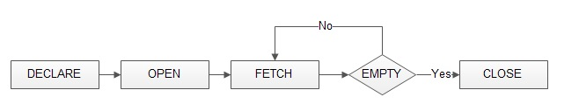
MySQL Cursor (4)
Statements for working with cursors:
  open cursor_name;
  fetch cursor_name
  into record_or_variable_list;
  close cursor_name;
Open causes the query defining the cursor to be executed.

Slide 33
MySQL Cursor (5)
A cursor always points to the prior row. Each fetch statement will first advance the cursor position by 1 and then retrieve the values in the pointed row.
A cursor can be re-opened after it is closed. Re-opened cursor points to the beginning of the table.
A cursor is not needed if you are sure that the result can have at most one row.
  In this case, you can use “select … into …”
游标充当指针的作用。尽管游标能遍历结果中的所有行，但他一次只指向一行。

Slide 34
MySQL Cursor (6)
When working with MYSQL cursor, also need to declare a NOT FOUND Handler to handle the situation when the cursor could not find any row when the next FETCH statement is executed.
Declare a NOT FOUND Handler
  declare continue handler for not found set finished = 1;

Slide 35
Example 10
mysql> delimiter //
mysql> create procedure build_email_list (inout email_list varchar(4000))
begin
declare v_finished int default 0;
declare v_email varchar(100) default '';
-- declare cursor for employee email
declare email_cursor cursor for select email from employees;
-- declare NOT FOUND handler
declare continue handler for not found set v_finished = 1;
open email_cursor;
get_email: loop
fetch email_cursor into v_email;
if v_finished = 1 then
leave get_email; -- exit the loop
end if;
-- build email list with “;” as the delimiter
set email_list = concat(v_email, ';', email_list);
end loop get_email;
close email_cursor;
end //

Slide 36
Example 10 (Continued)
mysql> delimiter ;
Test:
mysql> set @email_list = '';
mysql> call build_email_list(@email_list);
mysql> select @email_list;
Output :
@email_list
-----------------
a@gmail.com;b@gmail.com;c@gmail.com; (List of all email id separated by ;)

Slide 37
Stored Procedure/Function Information (1)
查看存储程序
To find information about a stored procedure or function, use the following statement:
Syntax:
  show procedure | function status [where expression];
Examples:
mysql> show procedure status;
mysql> show function status where name like '%product%‘;

Slide 38
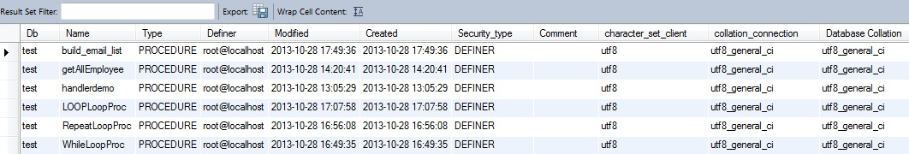
Sample Output of
“show procedure status” in Workbench

Slide 39
Stored Procedure/Function Information (2)
To see a stored procedure’s or function’s source code, use
show create procedure | function stored_procedure_name;
Examples:
mysql> show create procedure build_email_list;
mysql> show create function GetStudentSizeByDept2;

Slide 40
Trigger (触发器)
触发器（Trigger）是用户定义在关系表上的一类由事件驱动的特殊过程
  触发器保存在数据库服务器中
  任何用户对表的增、删、改操作均由服务器自动激活相应的触发器
  触发器可以实施更为复杂的检查和操作，具有更精细和更强大的数据控制能力

Slide 41
Trigger (2)
ECA Model:
Event Condition Action
MySQL currently only supports the event-action part.
an event
detected?
yes
Is the event
significant?
yes
take
actions
insert
delete
update
need to satisfy
additional
condition
execute
MySQL
block

Slide 42
Trigger (3)
Syntax for creating trigger:
create trigger trigger_name <触发器名>
{ before | after }
{ insert | update | delete } <触发事件> ON <表名>
on table_name
for each row
<trigger body>
Syntax for deleting trigger:
drop trigger [if exists] trigger_name

Slide 43
Trigger (4)
Trigger event examples
  update on employees
  insert on employees
  delete on employees
trigger timing
  before: execute the trigger body before executing the triggering statement
  after: execute the trigger body after executing the triggering statement

Slide 44
Trigger (5)
row trigger
  “for each row” is specified
  Execute the trigger body once for each row that is affected by the event
statement trigger
  “for each row” is not specified
  fire the trigger once for the entire trigger event
  Statement trigger is not supported by MySQL.

Slide 45
Trigger (6)
Within the trigger body, the OLD and NEW keywords enable you to access columns in the rows affected by a trigger.
  In an INSERT trigger, only NEW.col_name can be used; there is no old row.
  In a DELETE trigger, only OLD.col_name can be used; there is no new row.
  In an UPDATE trigger, you can use OLD.col_name to refer to the columns of a row before it is updated and NEW.col_name to refer to the columns of the row after it is updated.
  用户都可以在过程体中使用NEW和OLD引用事件之后的新值和事件之前的旧值

Slide 46
Trigger (7)
A column named with OLD is read only.
In a BEFORE trigger, you can also change its value with “set NEW.col_name = value”.
  This makes it possible to use a trigger to modify the values to be inserted into a new row or used to update a row.
  Such a set statement has no effect in an AFTER trigger because the row change has already occurred.

Slide 47
Trigger Example 1
We want to insert tuples into table Sale(Percent, Sale_Date), where Percent must be between 5 and 80. Any attempt to insert a Percent below 5 will be replaced by 5 and that above 80 by 80. The Sale_Date value will be the current date.
mysql> create trigger before_insert_sale
before insert on Sale for each row
begin
set new.sale_date = curdate();
if new.percent < 5 then
set new.percent = 5;
elseif new.percent > 80 then
set new.percent = 80;
end if;
end //

Slide 48
Trigger Example 2
Use trigger for monitoring changes
Example: Add a log entry each time the price of a product is changed.
log table for product:
create table product_log
(pid varchar(4),
username varchar(20),
update_time datetime,
old_price decimal(6, 2),
new_price decimal(6, 2));

Slide 49
Sample Example 2 (Continued)
mysql> create trigger update_product_price
after update on products
for each row
begin
if old.price <> new.price then
insert into product_log values
(old.pid, user(), current_timestamp,
old.price, new.price);
end //

Slide 50
Trigger Example 3
Use trigger to enforce integrity constraints
Example: If a student is removed, delete all enrollments by the student.
mysql> create trigger stud_enroll
after delete on students
for each row
begin
delete from enrollments where sid = old.sid;
end //
If there is just one statement in the trigger body, “begin … end” is optional.

Slide 51
Trigger Example 4
Use trigger to maintain data consistency
Example: If an order is made for a product with certain quantity, then the quantity on hand of the product should be reduced accordingly.
mysql> create trigger prod_qoh_on_order
after insert on orders for each row
begin
update products
set quantity = quantity – new.qty
where pid = new.pid;
end //

Slide 52
Trigger Restrictions
Triggers can not:
  Modify a table being used by the DML without NEW or OLD aliases.
  Use SELECT without INTO variable_name.
  Use SHOW commands.
  Use ALTER VIEW.
  Use RETURN in stored programs.
  Use statements that explicitly or implicitly begin or end a transaction, such as “start transaction”, “commit”, or ”rollback”.

Slide 53
Handling Trigger Errors in MySQL
If a BEFORE trigger fails, the operation on the corresponding row is not performed.
A BEFORE trigger is activated by the attempt to insert or modify the row, regardless of whether the attempt subsequently succeeds.
An AFTER trigger is executed only if any BEFORE triggers and the row operation execute successfully.
An error during either a BEFORE or AFTER trigger results in failure of the entire statement that caused trigger invocation.
For transactional tables, failure of a statement causes rollback of all changes performed by the statement.
For non-transactional tables, rollback cannot be done, any changes performed prior to the error point remain in effect.

Slide 54
Events事件
In MySQL, an event is a stored program that executes according to a schedule. 根据时间设置启动一个事件
Basic create event syntax:
create event event_name
on schedule schedule_spec
do event_body;
  schedule_spec: at timestamp [+ interval interval_spec] | every interval [starts timestamp [+ interval interval_spec] ] [ends timestamp [+ interval interval_spec] ]
  interval_spec: quantity {year | quarter | month | day | hour | minute | week | second | year_month | day_hour | day_minute | day_second | hour_minute | hour_second | minute_second}

Slide 55
Event Example 1
Suppose we have table MySchedule(event_name, event_time, event_place).
Create an event that will add a tuple about a meeting into MySchedule 3 hours from now:
mysql> create event my_schedule
on schedule at current_timestamp
+ interval 3 hours
do insert into MySchedule values (‘faculty
meeting’, ‘2013-11-14 16:30:00’, ‘G11’);

Slide 56
Event Example 2
Create an event that removes activity tuples that have expired from MySchedule every day:
mysql> create event my_schedule
on schedule every 1 day
do delete from MySchedule
where event_time < current_timestamp;
  The event runs immediately after its creation and then once each day.

